Slide 1



Two Wheels Self-balancing Robot
Digital Control Systems
Students: Simone Orelli, Antonio Rapuano, Francesco Russo.
DEPARTMENT OF COMUPUTER, CONTROL AND MANAGMENT ENGINEERING ANTONIO RUBERTI
Professor: Claudia Califano

Slide 2

Outline
Introduction
Sensor Data Acquisition
Hardware
Demo
Model
Future Developments
Simulation
Conclusion

Slide 3

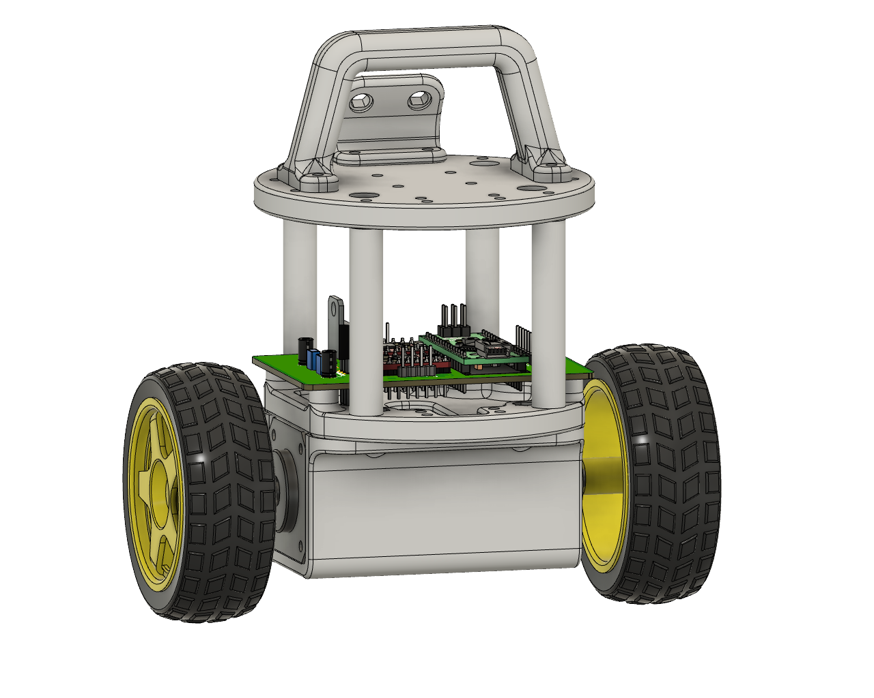
Introduction
Goal
The aim of this project is to build a wheeled robot with the remarkable capability of autonomously maintaining balance.
The heart of this project is the ambition to empower the robot with the ability to dynamically adapt to variations in its surrounding environment.
Physical Structure
The physical structure of the robot has been designed using Autodesk Inventor and subsequently manufactured with a 3D printer.
The material chosen to print the robot is PLA, which offers good strength and rigidity.

Slide 4
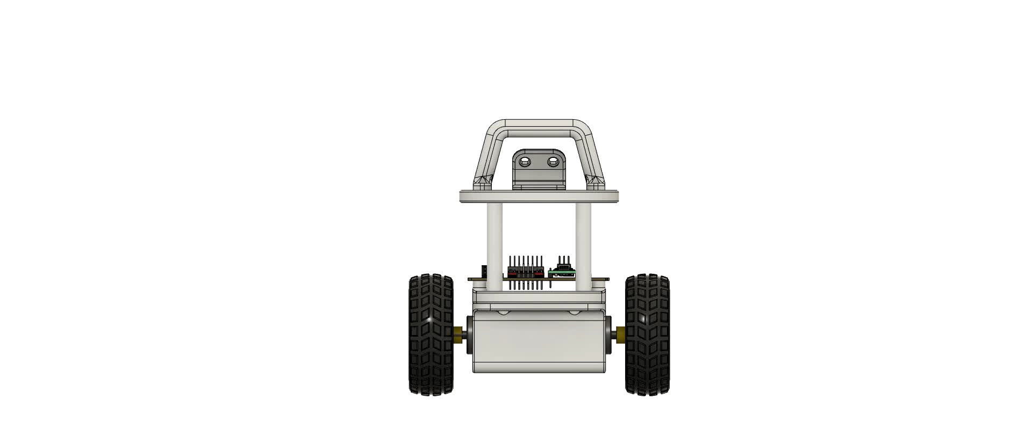
Hardware
Two Wheels Self Balancing Robot 3D Model
Actuation Devices:
Stepper Motor NEMA 14

Slide 5
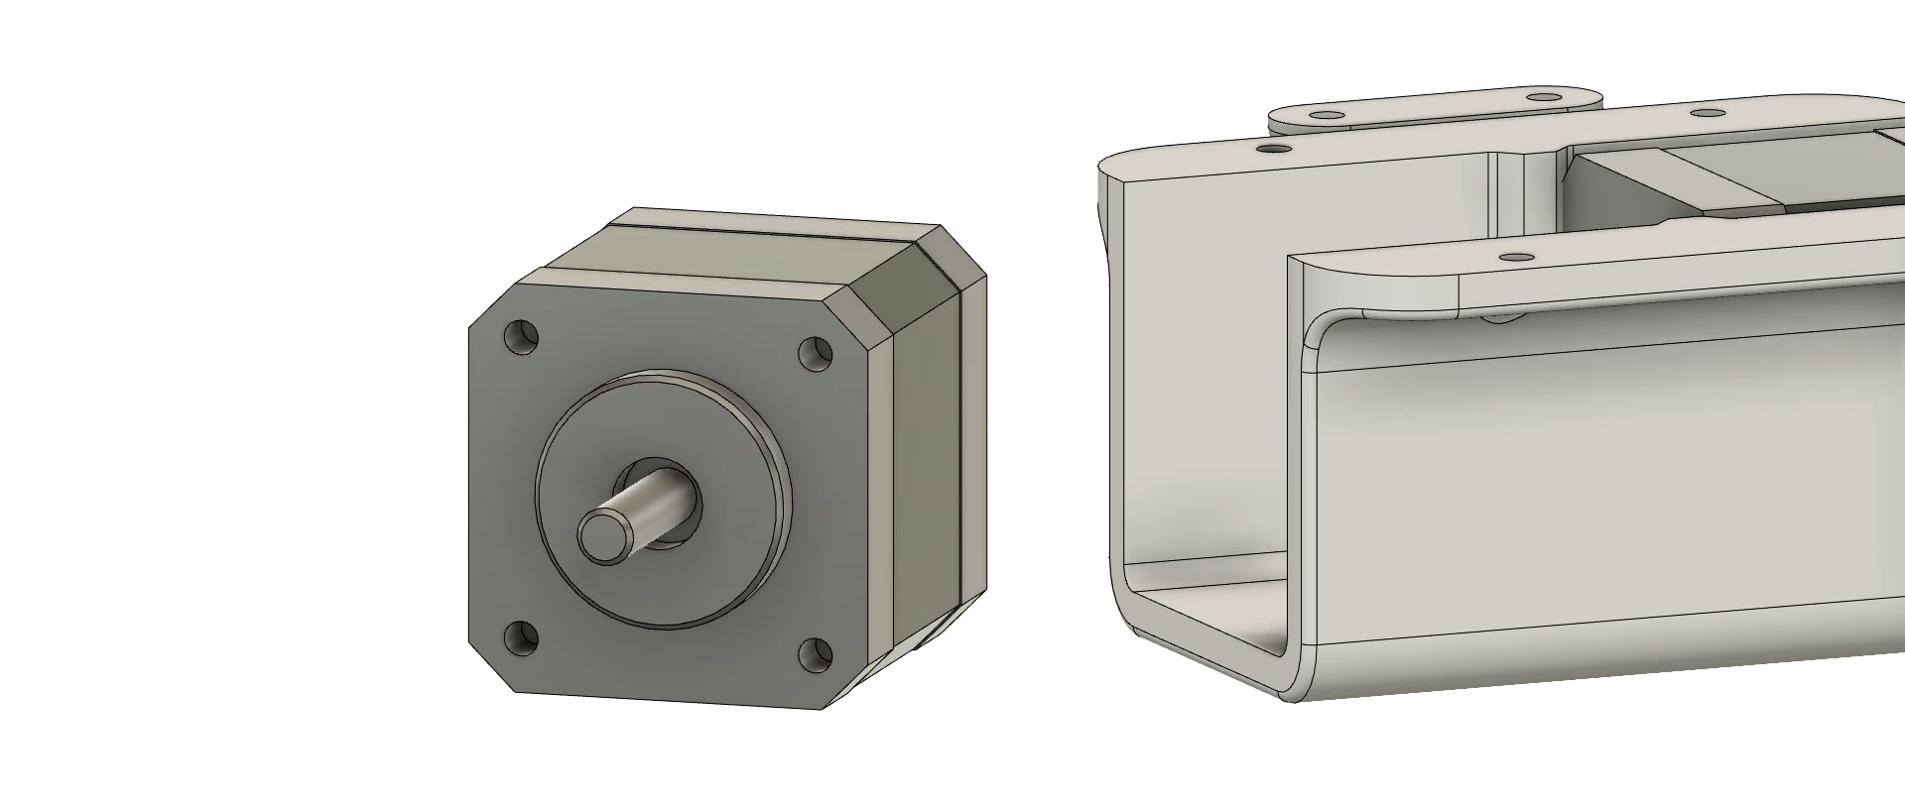
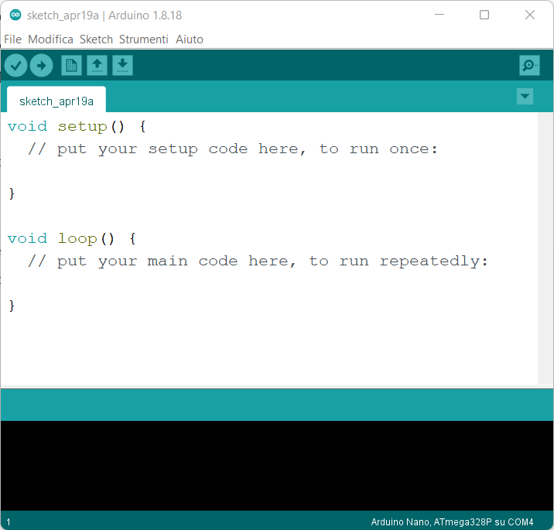
Hardware
Two Wheels Self Balancing Robot 3D Model
PCB:
Voltage Regulator
Arduino Nano
Driver A4988
MPU-6050
IDE

Slide 6
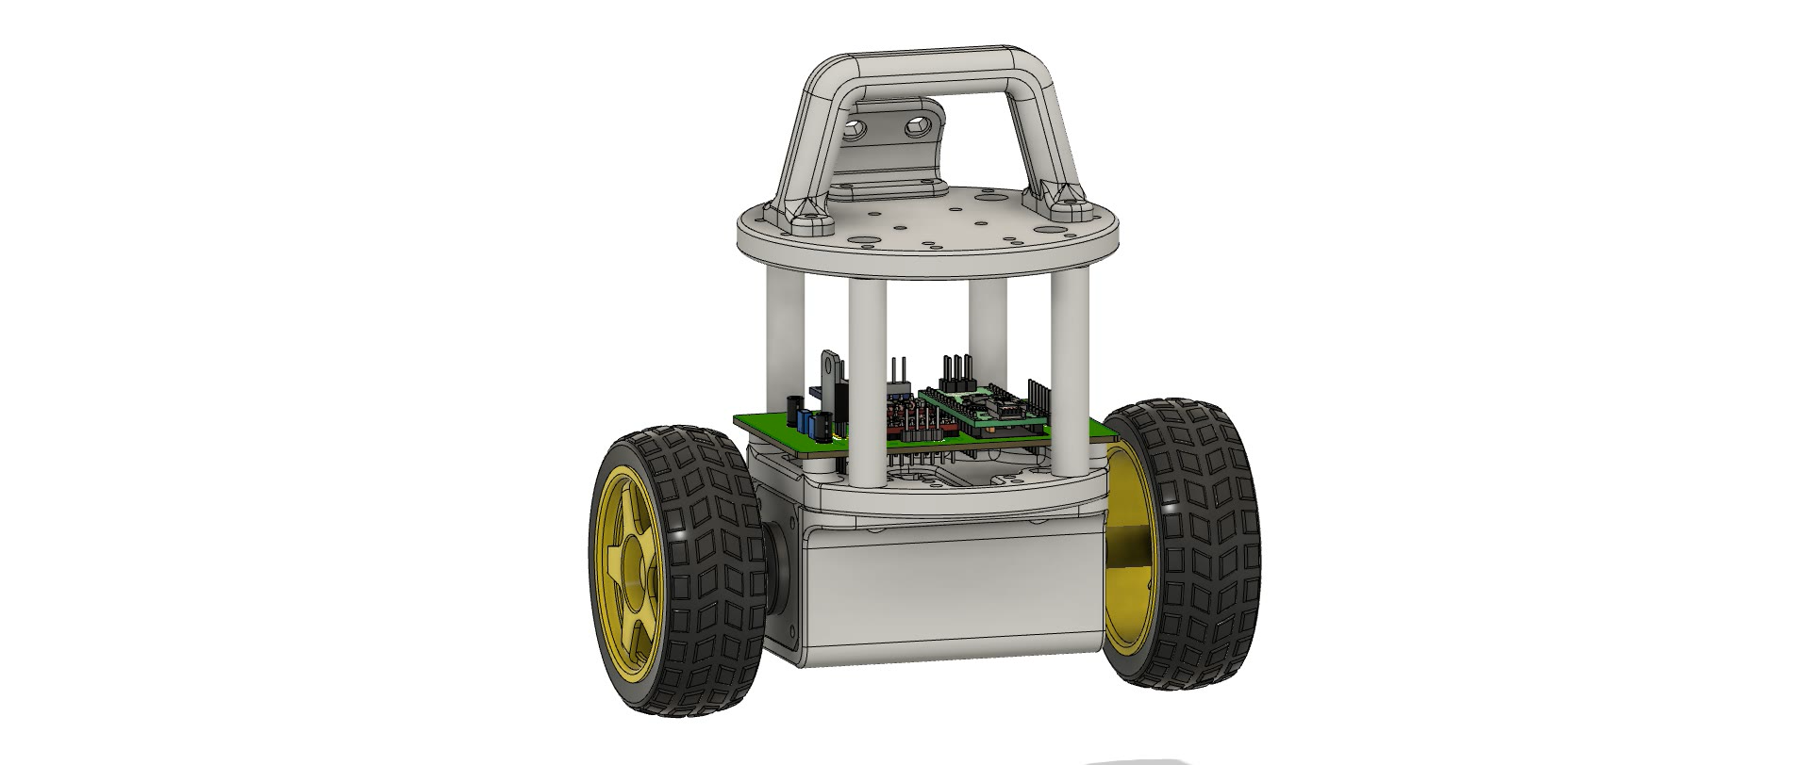
Hardware
Two Wheels Self Balancing Robot 3D Model

Slide 7
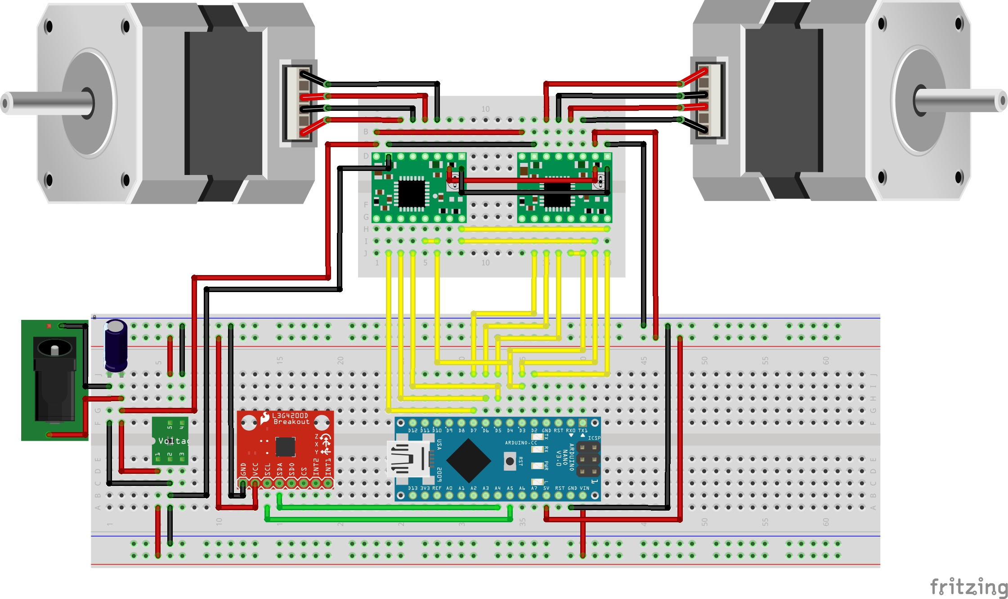
Hardware
Electrical Scheme
CONNECTIONS
Driver A4988:
DIR -> D2
STEP -> D3
SLEEP -> D4
RESET -> D4
MS3 -> D5
MS2 -> D6
MS1 -> D7
MPU - 6050:
SCL -> A4
SDA -> A5

Slide 8

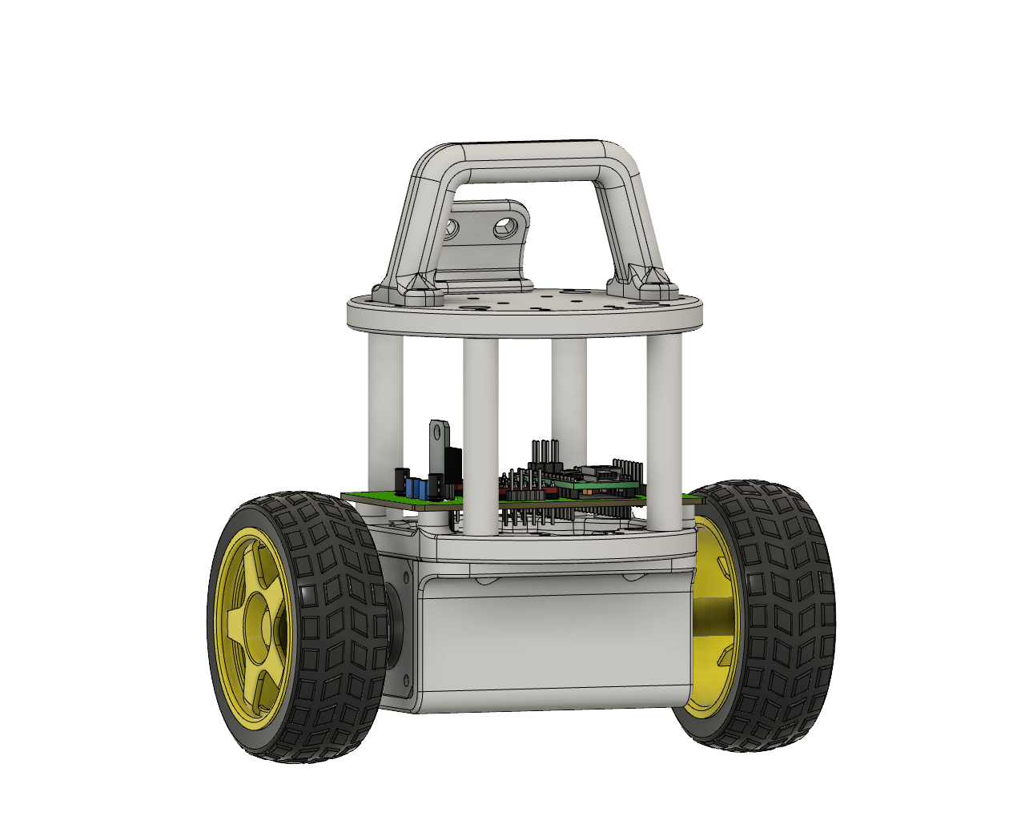
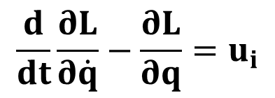

Model
Lagrangian Method
To find the dynamics of the TWSBR system we used the Lagrangian method, instead of the Newtonian one.
The Lagrangian function is defined as:
$$L = T − V$$
where T is the kinetic energy and V is the potential energy.
It is used into the Euler-Lagrange equation:
$$\frac{d}{dt}\frac{∂L}{∂\dot{q}}−\frac{∂L}{∂q}=u_{i}$$
where $u_{i}$ are non-conservative (external or dissipative) generalized forces performing work on $q_{i}$.

Slide 9
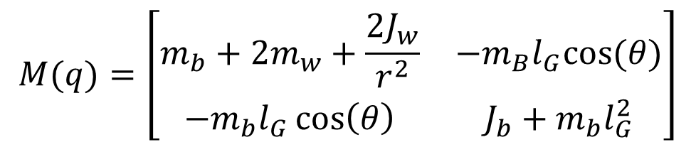
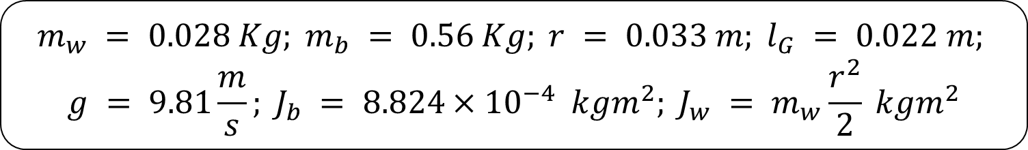


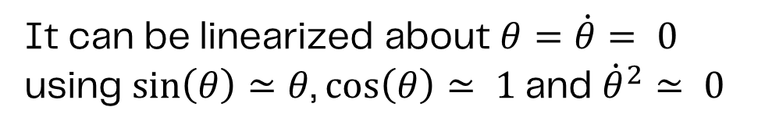

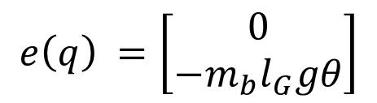
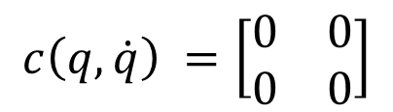
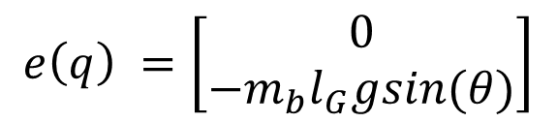
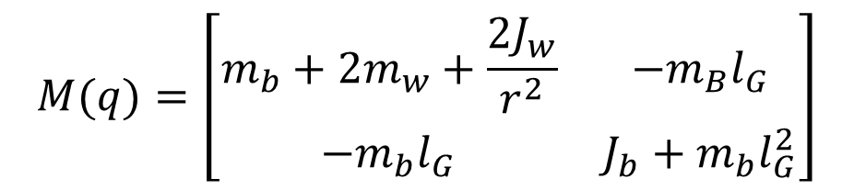
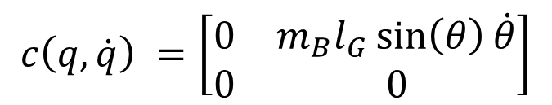
Model
Lagrangian Method
Euler-Lagrange equation
$$M\left(q\right)\ddot{q}+c\left(q,\dot{q}\right) \dot{q}+e\left(q\right)=Hτ$$
$$M(q)=\left[\begin{matrix}m_{b}+2m_{w}+\frac{2J_{w}}{r^{2}} & −m_{B}l_{G} \\ −m_{b}l_{G} & J_{b}+m_{b}l_{G}^{2}\end{matrix}\right]$$
$$M(q)=\left[\begin{matrix}m_{b}+2m_{w}+\frac{2J_{w}}{r^{2}} & −m_{B}l_{G}cos⁡(θ) \\ −m_{b}l_{G}\cos\left(θ\right) & J_{b}+m_{b}l_{G}^{2}\end{matrix}\right]$$
$$H=\left[\begin{aligned}\frac{1}{r} \\ 1\end{aligned}\right]$$
$$H=\left[\begin{aligned}\frac{1}{r} \\ 1\end{aligned}\right]$$
$$c\left(q,\dot{q}\right) =\left[\begin{matrix}0 & m_{B}l_{G}\sin\left(θ\right)\dot{θ} \\ 0 & 0\end{matrix}\right]$$
$$e\left(q\right) =\left[\begin{aligned}0 \\ −m_{b}l_{G}gsin(θ)\end{aligned}\right]$$
$$c\left(q,\dot{q}\right) =\left[\begin{matrix}0 & 0 \\ 0 & 0\end{matrix}\right]$$
$$e\left(q\right) =\left[\begin{aligned}0 \\ −m_{b}l_{G}gθ\end{aligned}\right]$$
$$m_{w} = 0.028 Kg; m_{b} = 0.56 Kg; r = 0.033 m; l_{G} = 0.022 m;$$
$$g = 9.81\frac{m}{s}; J_{b} = 8.824{×10}^{−4} kgm^{2}; J_{w} = m_{w}\frac{r^{2}}{2} kgm^{2}$$
It can be linearized about $θ=\dot{θ}= 0$
using $\sin\left(θ\right)≃θ$, $\cos\left(θ\right)≃ 1$and ${\dot{θ}}^{2}≃ 0$

Slide 10
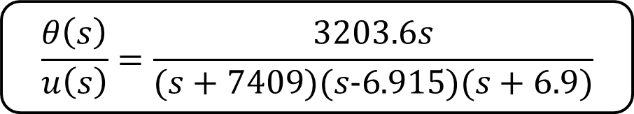
Model
Transfer Function Representation
The stepper motors make the system act like a closed loop, applying the necessary torque to reach the desired motor shaft angular speed.
Because of this, there is no need to use angular encoders, but this kind of representation requires to be tuned accurately according to the motor specifications.
Transfer function between pitch angle and motor input:
$$\frac{θ\left(s\right)}{u\left(s\right)}=\frac{3203.6s}{(s+7409)(s−6.915)(s+6.9)}$$
Stability
The TWSBR is an unstable system because its transfer function has an unstable pole in $p=6.915$.

Slide 11
Control System
Angle Setpoint
Angle Error
+
Angular Outputs
Controller
Actuators
System
-
Feedback Signal
Sensors
Feedback signals: Angular measurements $\text{θ}$and $\dot{\text{θ}}$
Control signal: Angular velocity of the stepper motor shaft

Slide 12
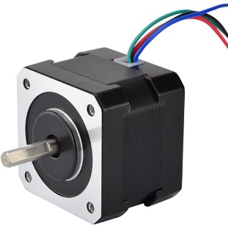
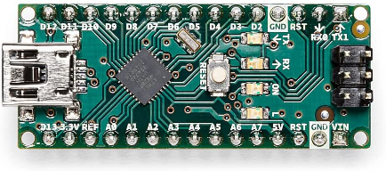
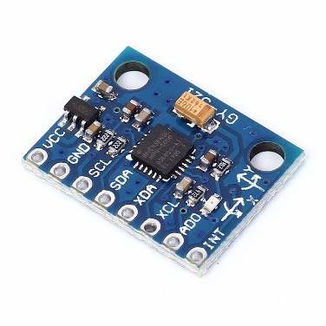
Control System
Stepper Motor
Angle Setpoint
Angle Error
+
Angular Outputs
Actuators
System
-
Arduino Nano
Feedback Signal
Sensor
MPU-6050
Feedback signals: Angular measurements $\text{θ}$and $\dot{\text{θ}}$
Control signal: Angular velocity of the stepper motor shaft

Slide 13
Control System
Stepper Motor
Angle Setpoint
Angle Error
+
Actuators
Angular Outputs
-
Arduino Nano
Feedback Signal
Sensor
MPU-6050
Feedback signals: Angular measurements $\text{θ}$and $\dot{\text{θ}}$
Control signal: Angular velocity of the stepper motor shaft

Slide 14



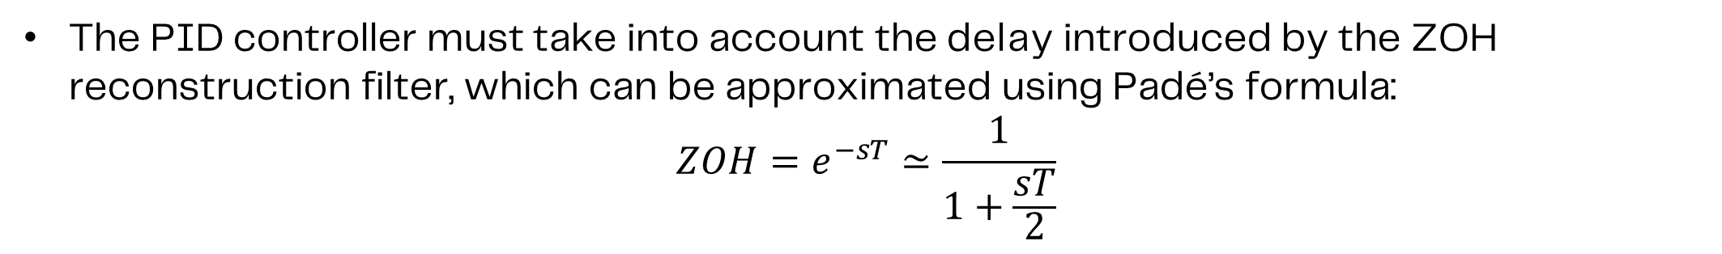

Simulation
Continuous Controller
Continuous representation of the discrete closed loop with the PID controller:
Proportional Action
+
$$e(t)$$
Integral Action
+
+
Output
Reference
$$u(t)$$
ZOH delay
Process
$$r(t)$$
-
+
$$y(t)$$
Derivative Action
The PID controller must take into account the delay introduced by the ZOH reconstruction filter, which can be approximated using Padé’s formula:
$$ZOH=e^{−sT}≃\frac{1}{1+\frac{sT}{2}}$$

Slide 15





Simulation
Discretized Controller
The only difference lies in the way the derivative and the integral operations are computed.
Proportional Action
Discrete reference
$$e(k)$$
Integral Action
+
+
+
$$u(k)$$
Reconstructor (ZOH)
$$u′(t)$$
Process
Output
$$r(k)$$
-
+
$$y(t)$$
$$y(k)$$
Derivative Action
Sampler
The sampling time is chosen sufficiently shorter than the maximum imposed by Shannon’s theorem considering the bandwidth of the system.
Kp = -50 Kd = -1 Ki = -375
T = 0.02 s

Slide 16
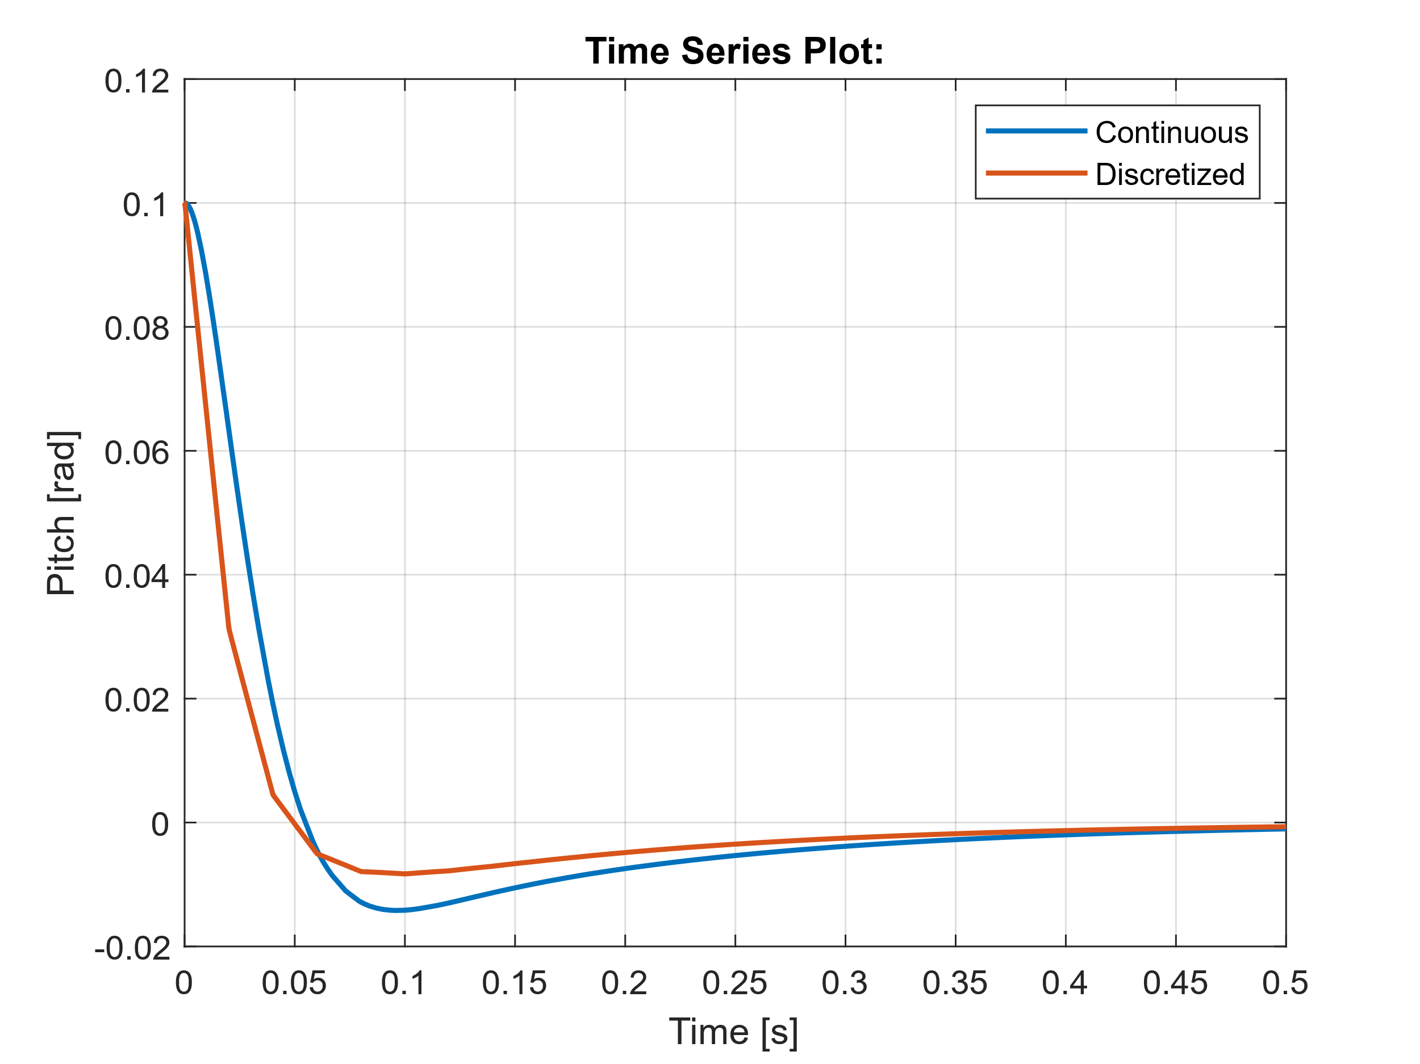
Simulation
Evolution of the closed-loop TWSBR system with null reference.
Orange line: Closed-loop response when employing the continuous version of the system.
Blue Line : Closed-loop response when using the discrete implementation of the continuous controller.

Slide 17
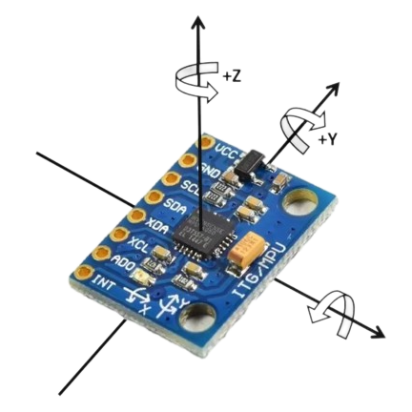
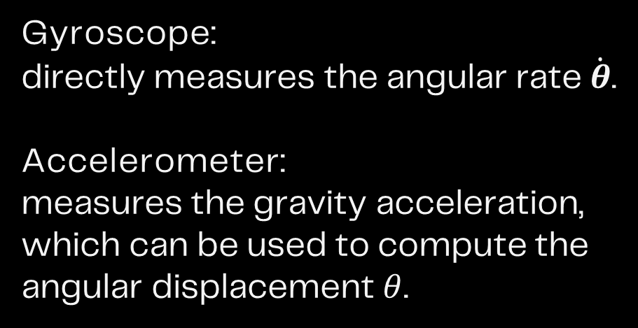
Sensor Data Acquisition
MPU6050
}
Gyroscope:
directly measures the angular rate $\dot{θ}$.
Accelerometer:
measures the gravity acceleration, which can be used to compute the angular displacement $θ$.
Sensor data fusion
+X

Slide 18
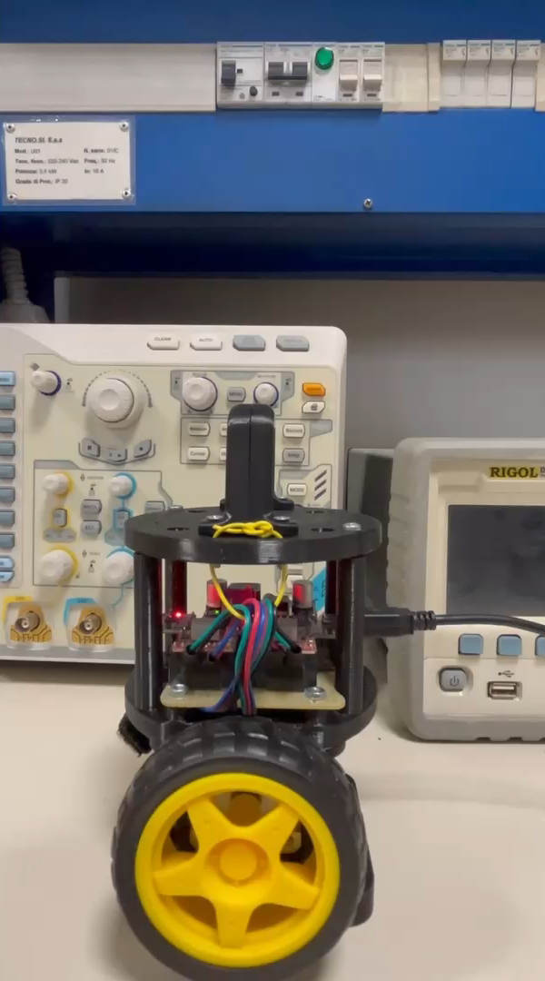
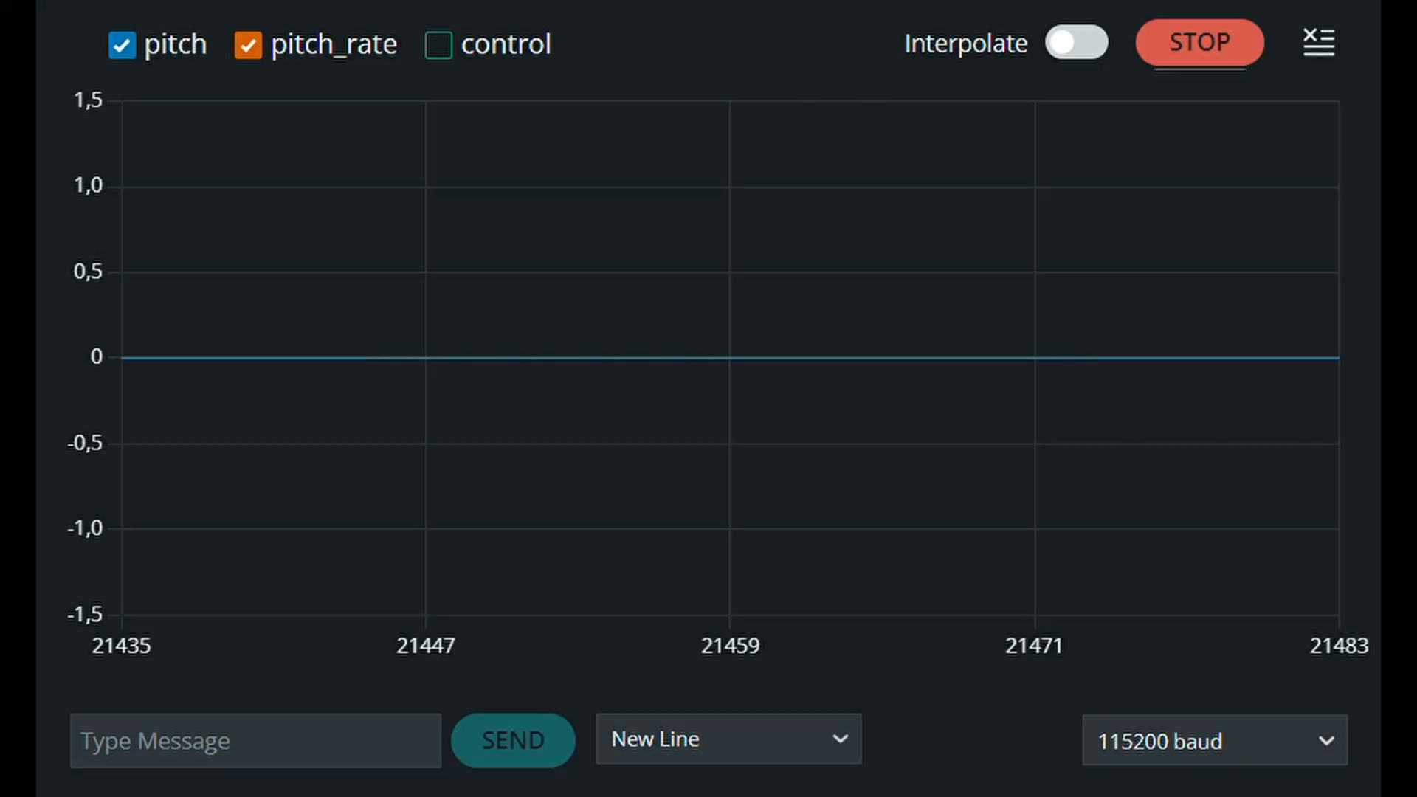
Sensor Data Acquisition
Significant presence of measurement noise

Slide 19
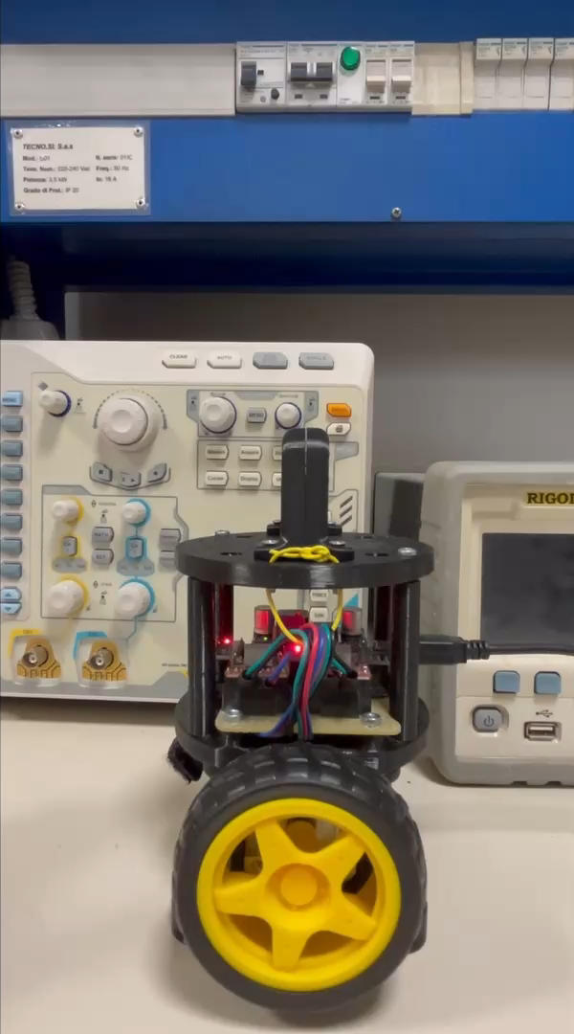

Sensor Data Acquisition
Low-pass filter + Kalman filter
Low-pass filter for high-frequency noise reduction (e.g. vibrations)
Kalman filter for sensor data fusion and state reconstruction

Slide 20
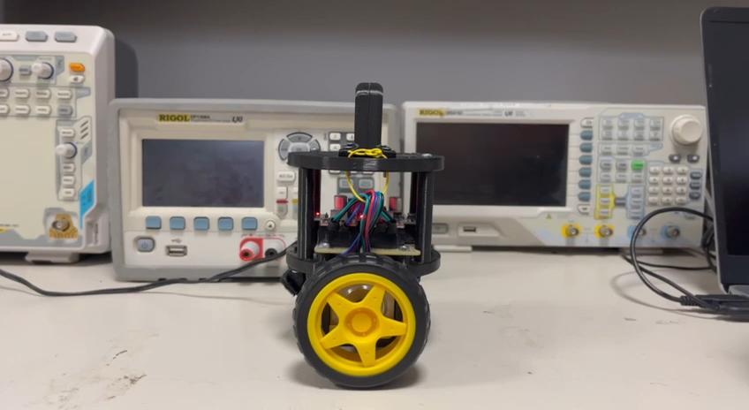
Demo

Slide 21
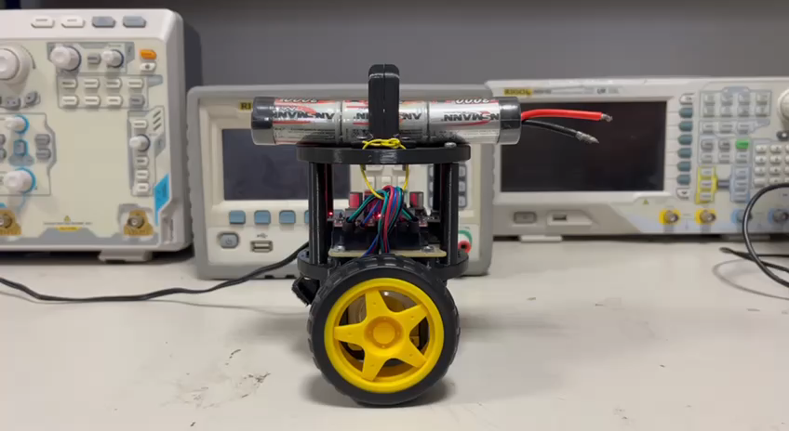
Demo

Slide 22
Future Developments
Integrate an additional controller in cascade control configuration so that the robot can track a speed reference.
Integrate an ultrasonic distance sensor (e.g. HC-SR04) to introduce the perception of its surrounding.
Implement an Adaptive Cruise Control (ACC) algorithm to adjust the speed to maintain a safety distance from a moving target.

Slide 23
Conclusion
The main objective of the project was to implement a control system to maintain balance for a wheeled robot.
We adopted the model-based design approach, using MATLAB and Simulink to simulate the controller's behaviour.
Our model proved to be accurate, reflecting the dynamics of the physical robot (some fine-tuning was necessary anyway).
During the implementation in Arduino, we faced significant challenges, particularly related to the limited computational capacity of the board.
However, through code optimization and streamlining, we successfully overcame these obstacles and got a working system.
The result is a robot that maintains balance in a robust fashion, demonstrated both in simulation and in the real world, proving that the model and the software are reliable, ensuring stability even in the face of external disturbance.

Slide 24
Thanks For Your Attention

